Slide 1

GROUP -
NAME ROLL NO. SECTION
ARYAN RAJ
PAWAN KUMAR
MD. FAISAL RAZA
KRISHNA KUMAR sah
11242595
11242594
11242525
11242701
B1
B3
B3
B2

Slide 2
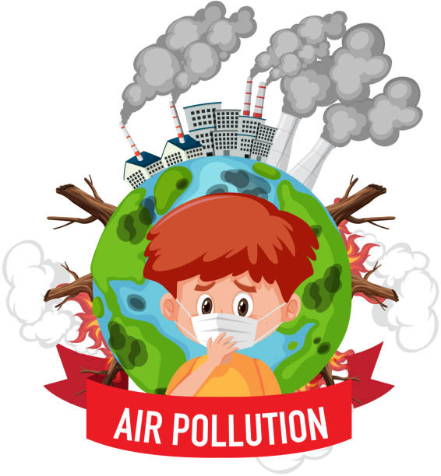
AIR POLUTION

Slide 3
What is Air Polution?
Air pollution is the contamination of the air by harmful substances, such as gases, particles, and biological molecules, that can cause adverse effects on human health and the environment.

Slide 4
Types of Air Pollution
1. Particulate Matter (PM): Tiny particles suspended in the air, including dust, soot, and aerosols, that can penetrate deep into the lungs.
2. Gaseous Pollutants: Harmful gases released into the air, including:
- Nitrogen Oxides (NOx): Contribute to ground-level ozone formation and respiratory problems.
- Sulfur Dioxide (SO2): Contributes to acid rain and respiratory problems.
- Carbon Monoxide (CO): Interferes with oxygen delivery to the body's organs.
3. Volatile Organic Compounds (VOCs): Chemicals that evaporate easily and contribute to ground-level ozone formation and respiratory problems.

Slide 5
Indore polution

